Slide 1
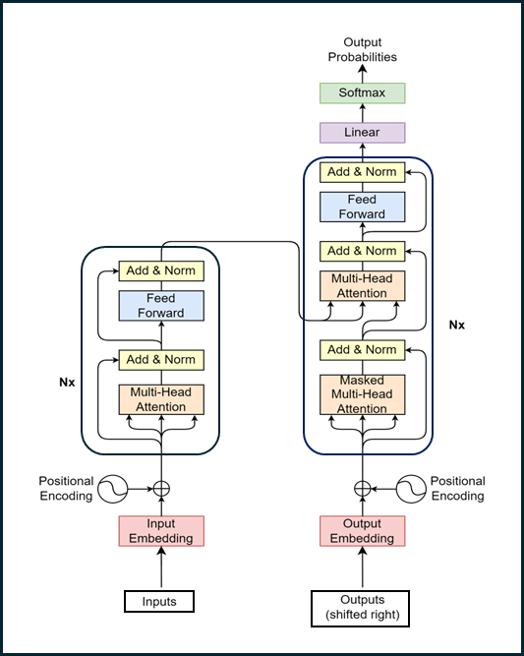
Part 2 – Introduction to Transformer
Quang Duong

Slide 2
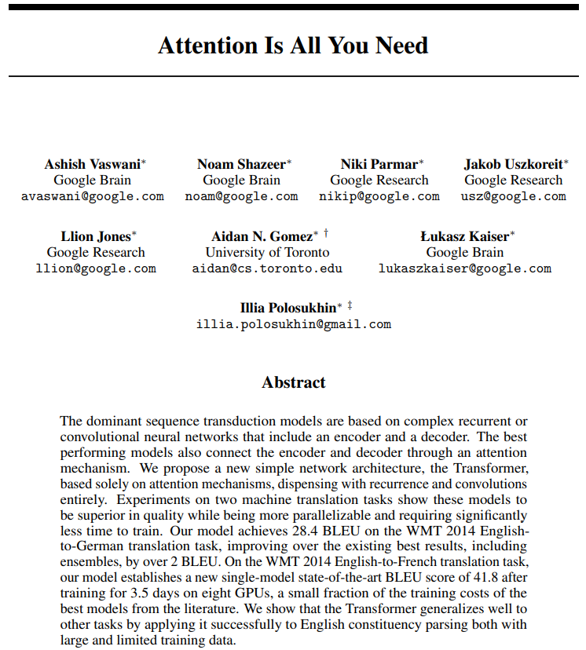
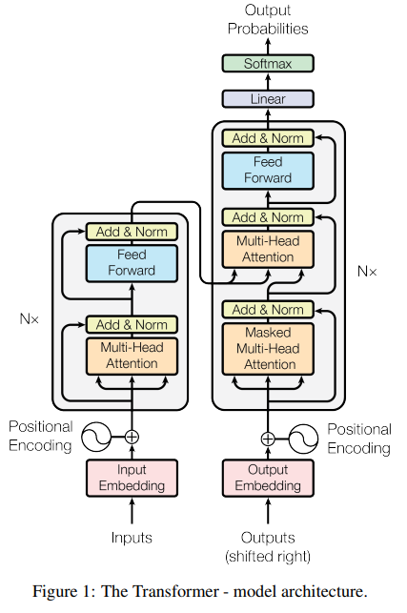
Transformer
Attention Is All You Need, A. Vaswani et al, 2017, https://arxiv.org/abs/1706.03762

Slide 3
What We Will Learn
Natural Language Processing (NLP) before and after Transformer's arrival
Mastering Transformer's block-by-block
Transformer's training process
Transformer's inference process

Slide 4
NLP Before & After Transformer's Arrival

Slide 5
NLP Before Transformer's Arrival in 2017
Recurrent Neural Networks (RNNs)
Long Short-Term Memory (LSTM) networks
Gated Recurrent Units (GRU)
2017
RNNs
Transformer

Slide 6
Some Advantages of RNNs
Efficient handling of sequential data types such as text, speech, and time series.
Ability to process inputs of variable lengths, a feature lacking in feedforward neural networks.
Enhanced training efficiency due to weight sharing across different time steps.

Slide 7
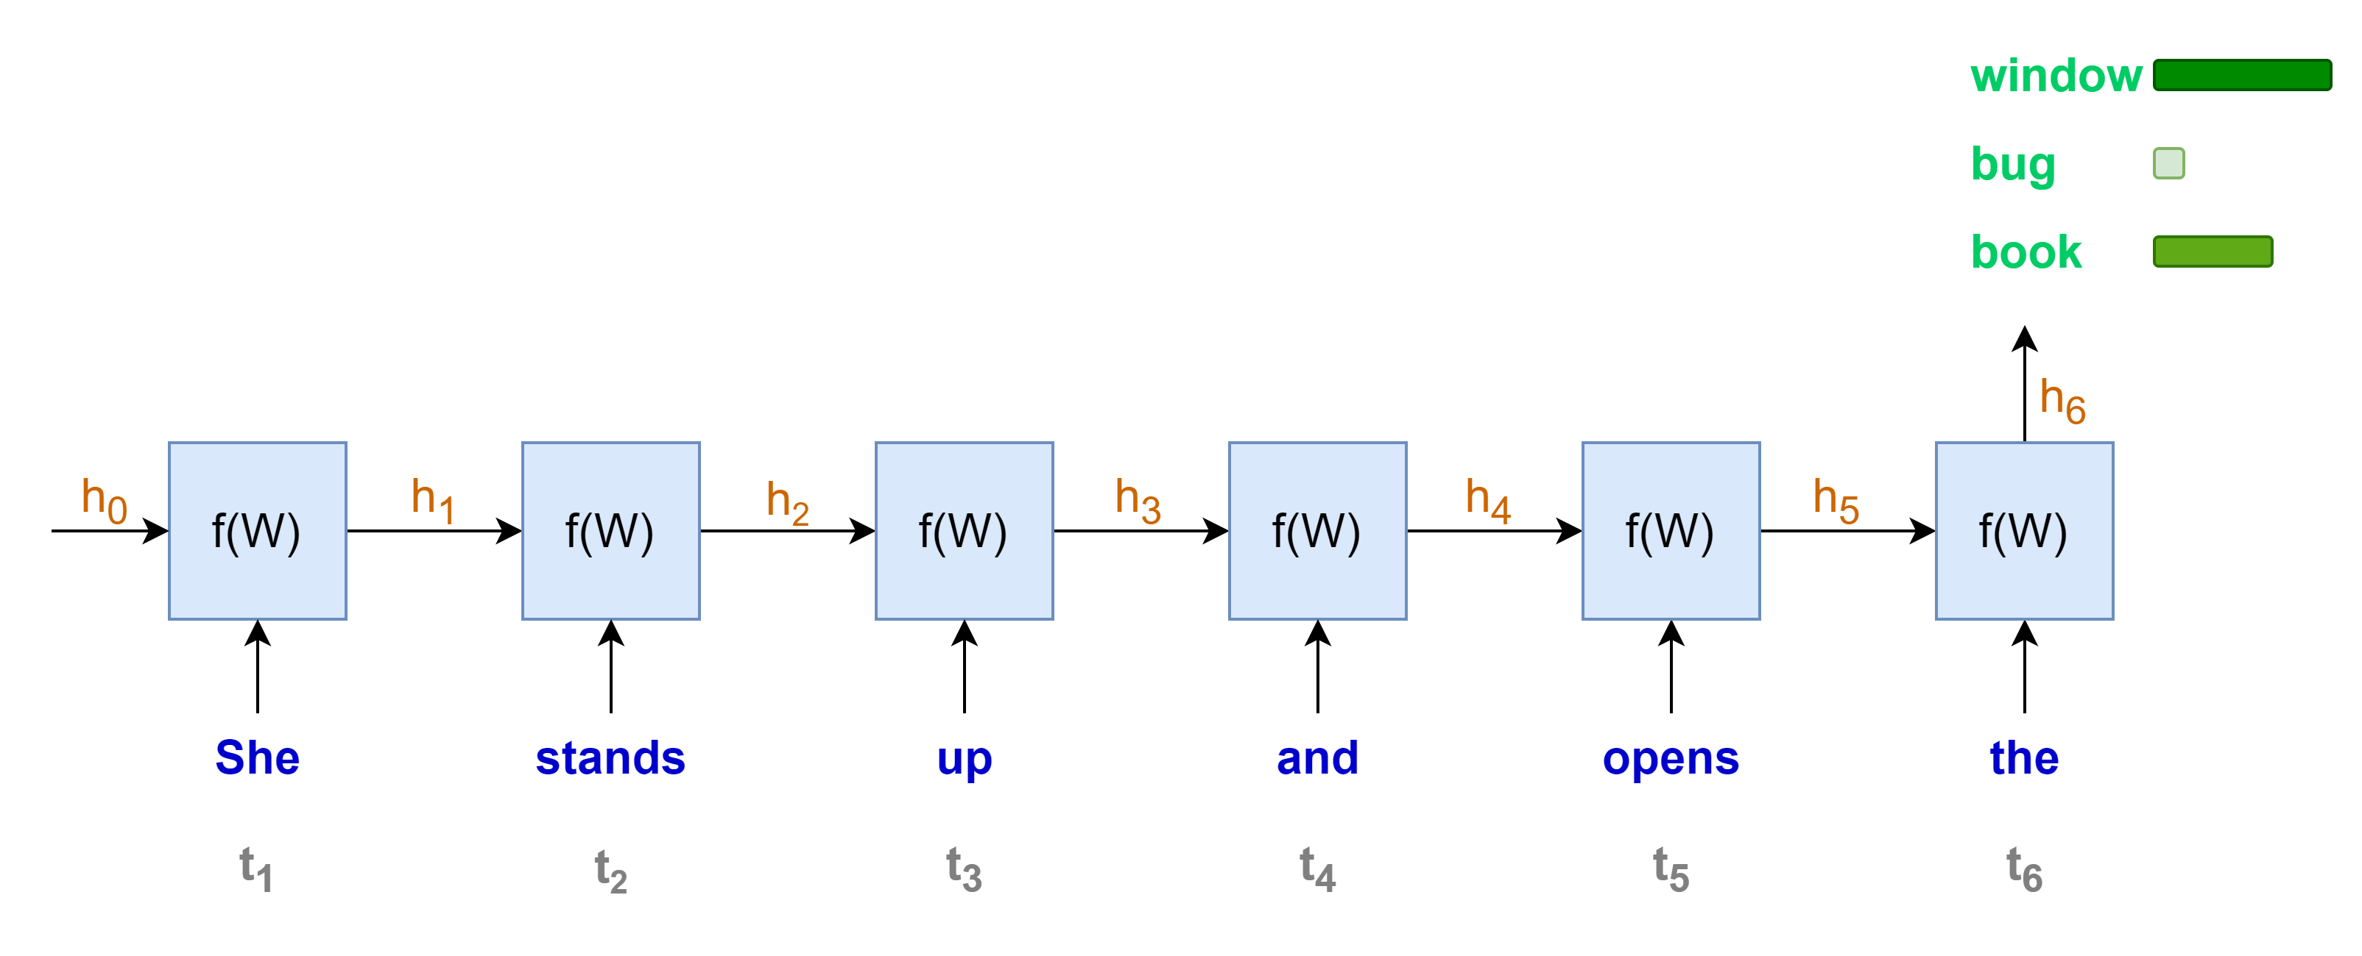
Some Disadvantages of RNNs (1/3)
Sequential computation, one word at a time
Less rooms for parallel computation
Longer sequence, longer computation time
“She stands up and opens the …”

Slide 8
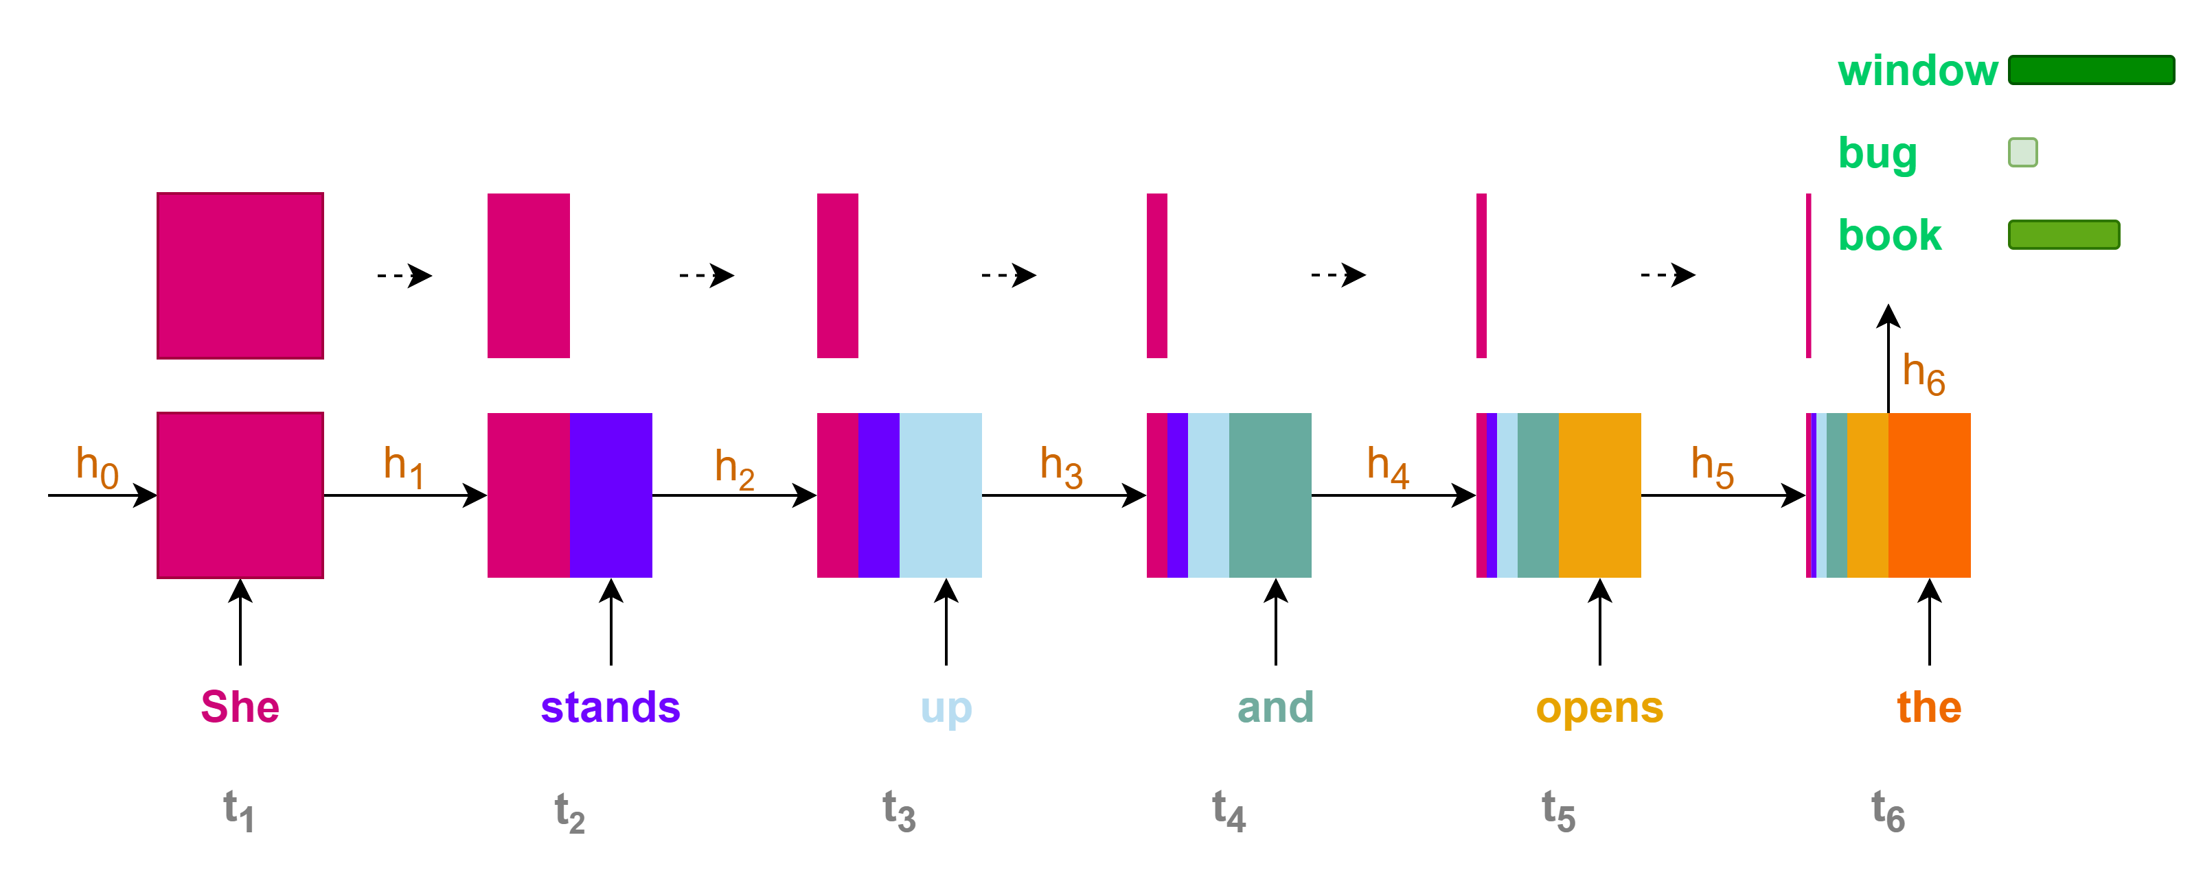
Some Disadvantages of RNNs (2/3)
Contributions of initial states or information to the final state or prediction are very small for long sequence context
Loss of information for long-range dependencies

Slide 9
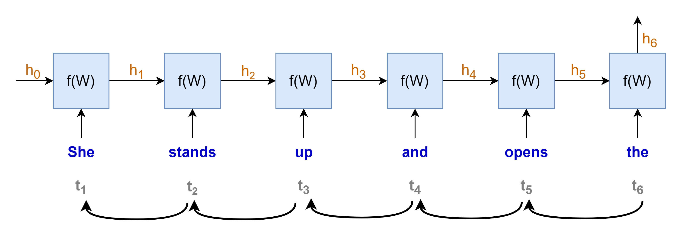
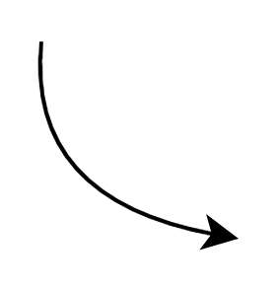
















Some Disadvantages of RNNs (3/3)
Training with Backpropagation Through Time
Vanishing or exploding gradients problems
hindering the learning process, especially for long sequences
making the training process highly unstable
$$gradient products$$
$$\frac{∂h_{t}}{∂h_{t−1}}≪1 →very small→"vanished"$$
$$\frac{∂h_{t}}{∂h_{t−1}}≫1 →very large→"exploded"$$
$$\frac{∂h_{1}}{∂W}$$
$$\frac{∂h_{2}}{∂h_{1}}$$
$$\frac{∂h_{3}}{∂h_{2}}$$
$$\frac{∂h_{4}}{∂h_{3}}$$
$$\frac{∂h_{5}}{∂h_{4}}$$
$$\frac{∂h_{6}}{∂h_{5}}$$
$$×$$
$$×$$
$$×$$
$$×$$
$$×$$
$$\frac{∂L}{∂W}=\frac{∂L}{∂y}\frac{∂y}{∂h_{6}}$$
$$×$$
“chain rule”

Slide 10
Some Disadvantages of RNNs
Sequential computation, hard to parallel computation with GPU
Loss of information for long-term dependencies
Vanishing or exploding gradient problems
2017
RNNs

Slide 11
The Arrival of Transformer
2017
RNNs
Transformer
"Attention Is All You Need"

Slide 12


Transformer for Machine Translation
Prediction
"Je vais bien"
Transformer
Decoder
Encoder
Source
"I am fine"
Simplified transformer architecture

Slide 13
RNNs vs Transformers
RNNs with their limitations
Transformers with self-attention
Sequential computation, hard to parallel computation with GPU
Loss of information for long-term dependencies
Vanishing or exploding gradient problems
Parallel computation
Leveraging GPU
Capture long-range dependencies
Less prone to vanishing or exploding gradient

Slide 14
NLP After Transformer's Arrival in 2017
Pre-Trained Language Models
BERT: 2018
GPT 2018 (for GPT-1)
T5: 2019
Llama: 2023 (for Llama 2)
Mistral: 2023
Phi: 2023
Falcon: 2023
Qwen: 2023
Gemma: 2024
To name but a few
2017
2018
RNNs
Transformer
Pre-trained Language Models

Slide 15
Mastering Transformer's Block-by-Block

Slide 16
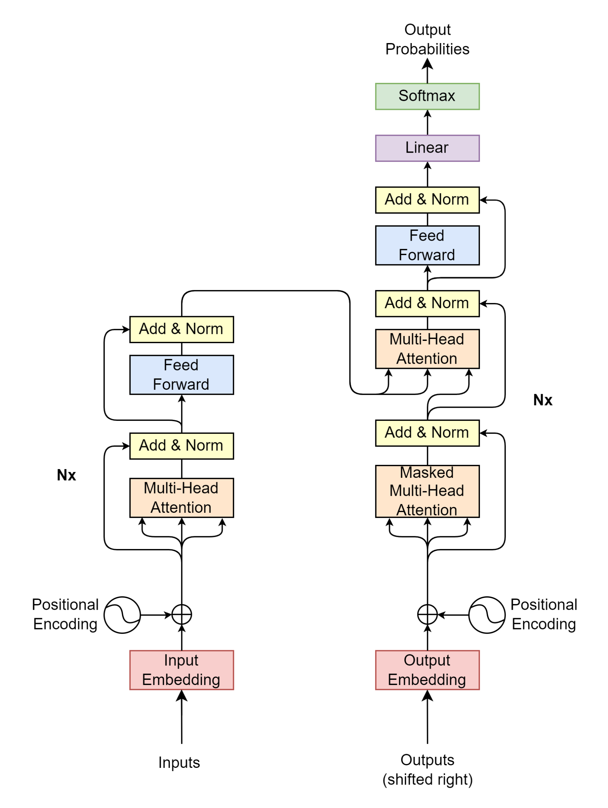
Transformer Block-by-Block
Prediction Output
How does the model understand text data?
What are the input, output, and process of each block?
Decoder
Encoder
Encoder Input
Decoder Input

Slide 17
Inputs / Outputs

Slide 18

Inputs / Outputs

Slide 19
Inputs / Outputs
Inputs
Outputs
Source
Target/Label
"I
am
fine"
"Thank
you
very
much"
"Je vais bien"
"Merci beaucoup"

Slide 20
Inputs/Outputs
Inputs
Outputs
Source
Target/Label
Source and target texts may have different lengths
→ A fixed length of the sequence vector is needed for the model's computation.
"I
am
fine"
"Thank
you
very
much"
"Je vais bien"
"Merci beaucoup"
e.g. len=7

Slide 21
Inputs/Outputs
Inputs
Outputs
Source
Target/Label
Source and target texts may have different lengths
→ A fixed length of the sequence vector is needed for the model's computation.
When to start and end model’s prediction ?
Find ways to notify the model when to start and end the prediction
"I
am
fine"
"Thank
you
very
much"
"Je vais bien"
"Merci beaucoup"
SOS
EOS
PAD
PAD
SOS
EOS
PAD
SOS
EOS
PAD
PAD
SOS
EOS
PAD
PAD
PAD

Slide 22
Inputs/Outputs
Inputs
Outputs
Source
Target/Label
Source and target texts may have different lengths
→ A fixed length of the sequence vector is needed for the model's computation.
When to start and end model’s prediction ?
Find ways to notify the model when to start and end the prediction
The model only understands numerical values
"I
am
fine"
"Thank
you
very
much"
"Je vais bien"
"Merci beaucoup"
SOS
EOS
PAD
PAD
SOS
EOS
PAD
SOS
EOS
PAD
PAD
SOS
EOS
PAD
PAD
PAD

Slide 23
Inputs/Outputs
Inputs
Outputs
Source
Target/Label
Source and target texts may have different lengths
→ A fixed length of the sequence vector is needed for the model's computation.
When to start and end model’s prediction ?
Find ways to notify the model when to start and end the prediction
Using Tokenizer to add special numerical values: 2 for SOS, 3 for EOS, 1 for Padding
The model only understands numerical values
→ Using Tokenizer to transform text into numerical representation.
"I
am
fine"
"Thank
you
very
much"
"Je vais bien"
"Merci beaucoup"
Tokenizer
2
9
107
550
3
1
1
2
2089
95
75
120
3
1
2
69
600
71
3
1
1
2
3546
324
3
1
1
1

Slide 24
Tokenizer
Contains a large vocabulary dictionary
Transforms text to numerical representation
A token can be a word or a character
Special tokens
UNK: Unknown
PAD: Padding
SOS: Start Of Sentence
EOS: End Of Sentence
{
…
"vocab": {
"[UNK]": 0,
"[PAD]": 1,
"[SOS]": 2,
"[EOS]": 3,
"I" : 9,
"you": 24,
"very": 75,
"am" : 107,
"much": 120,
"fine": 550,
"French": 582
"cook": 1779,
"Thank": 2089,
}
…
}

Slide 25
Tokenizer
Tokenizer
"I
am
fine"
encodes
9
107
550
decodes
"I
am
fine"

Slide 26

Preparing Inputs for Encoder Part
Source (max length: 4)
"I am fine"
"Thank you very much"
"I cook French cuisine"
Fixed length, SOS, EOS
For Inputs
SOS
I
am
fine
EOS
PAD
PAD
SOS
Thank
you
very
much
EOS
PAD
SOS
I
cook
French
cuisine
EOS
PAD
2
9
107
550
3
1
1
2
2089
95
75
120
3
1
2
9
1779
582
0
3
1
$seq$=7
Source tokenizer
encodes

Slide 27
Preparing Inputs for Decoder Part
Target (max length: 5)
"Je vais bien"
"Merci beaucoup"
"Je fais la cuisine française"
Fixed length, SOS, EOS
For Outputs (shifted right)
SOS
Je
vais
bien
PAD
PAD
PAD
SOS
Merci
beaucoup
PAD
PAD
PAD
PAD
SOS
Je
fais
la
cuisine
française
PAD
2
69
600
71
1
1
1
2
3546
324
1
1
1
1
2
69
1355
9
1390
5309
1
$seq$=7
Target tokenizer
encodes

Slide 28
Preparing Target for Loss Calculation
Target
Loss
Target (max length: 5)
"Je vais bien"
"Merci beaucoup"
"Je fais la cuisine française"
Fixed length, SOS, EOS
For Target in loss computation
Je
vais
bien
EOS
PAD
PAD
PAD
Merci
beaucoup
EOS
PAD
PAD
PAD
PAD
Je
fais
la
cuisine
française
EOS
PAD
69
600
71
3
1
1
1
3546
324
3
1
1
1
1
69
1355
9
1390
5309
3
1
$seq$=7
Target tokenizer
encodes

Slide 29
Encoder / Decoder Inputs

Slide 30
Encoder / Decoder Inputs
Prediction Output
Decoder
Encoder
Encoder Input
Decoder Input

Slide 31


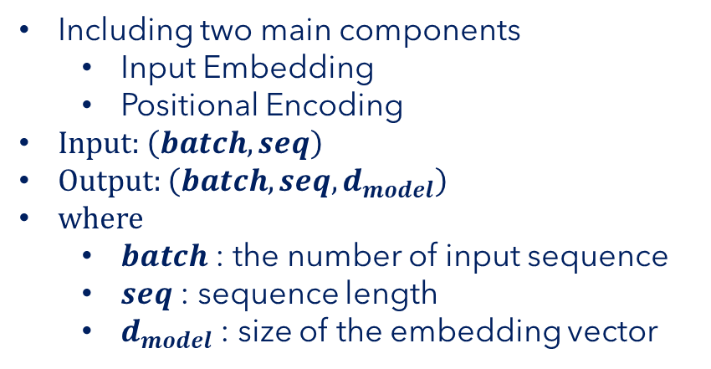





Encoder Input
Positional
Encoding
$$\left(batch, seq, d_{model}\right)$$
Including two main components
Input Embedding
Positional Encoding
Input: $\left(batch, seq\right)$
Output: $\left(batch, seq, d_{model}\right)$
where
$batch$ : the number of input sequence
$seq$ : sequence length
$d_{model}$ : size of the embedding vector
$$\left(batch, seq, d_{model}\right)$$
$$\left(batch, seq, d_{model}\right)$$
Encoder Input
Input Embedding
Inputs
$$\left(batch, seq\right)$$
2
9
107
550
3
1
1
"I
am
fine"
tokenizer
encodes
$$seq$$

Slide 32
Input Embedding

Slide 33



Input Embedding
$$d_{model}$$
… | … | … | … | …
523.415 | 1265.142 | … | 4189.251 | 16.416
452.716 | 6234.624 | … | 412.414 | 1794.127
7745.984 | 1314.124 | … | 65.764 | 1543.345
… | … | … | … | …
… | … | … | … | …
… | … | … | … | …
$$seq$$
A simple lookup table/matrix that stores embeddings of a fixed dictionary and size
Using a pre-trained embedding matrix or learned during training.
Mapping raw input tokens into dense vectors of fixed dimensions
The value of each token is the index in the Input Embedding matrix
Capturing the semantic meaning of the tokens
$$\left(batch, seq, d_{model}\right)$$
Input Embedding
Inputs
$$d_{model}$$
$$\left(batch, seq\right)$$
0
… | … | … | … | …
… | … | … | … | …
523.415 | 1265.142 | … | 4189.251 | 16.416
… | … | … | … | …
452.716 | 6234.624 | … | 412.414 | 1794.127
… | … | … | … | …
7745.984 | 1314.124 | … | 65.764 | 1543.345
… | … | … | … | …
2
9
107
550
3
1
1
9
Vocabulary
size
"I
am
fine"
tokenizer
encodes
107
$$seq$$
550

Slide 34
Positional Encoding

Slide 35


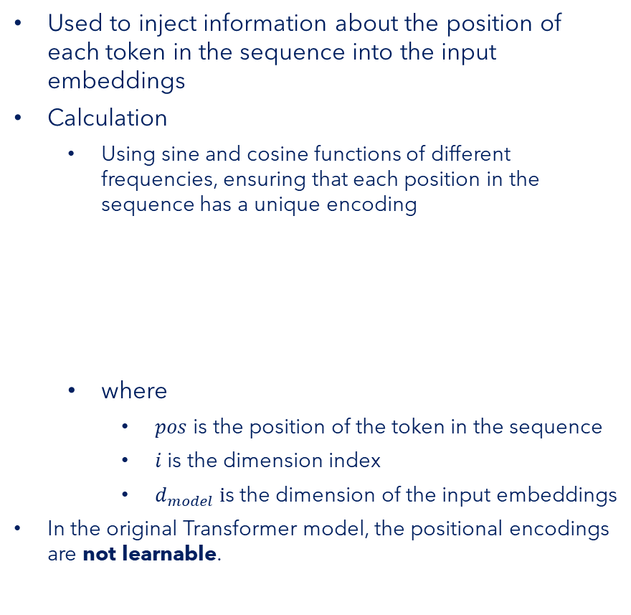







Positional Encoding
$$d_{model}$$
… | … | … | … | …
PE(1,0) | PE(1,1) | … | … | …
PE(2,0) | PE(2,1) | … | … | …
PE(3,0) | PE(3,1) | … | … | …
… | … | … | … | …
… | … | … | … | …
… | … | … | … | …
$$pos=0$$
$pos=$1
Used to inject information about the position of each token in the sequence into the input embeddings
Calculation
Using sine and cosine functions of different frequencies, ensuring that each position in the sequence has a unique encoding
where
$pos$ is the position of the token in the sequence
$i$is the dimension index
$d_{model} i$s the dimension of the input embeddings
In the original Transformer model, the positional encodings are not learnable.
$$⋮$$
$$seq$$
$$pos$$
$$=seq−1$$
$$\left(batch, seq, d_{model}\right)$$
Positional
Encoding
PE$\left(pos, 2i\right)=\sin\left(\frac{pos}{{10000}^{\frac{2i}{d_{model}}}}\right)$
Inputs
PE$\left(pos, 2i+1\right)=\cos\left(\frac{pos}{{10000}^{\frac{2i}{d_{model}}}}\right)$
$$\left(batch, seq\right)$$
2
9
107
550
3
1
1
"I
am
fine"
tokenizer
encodes
$$seq$$

Slide 36








Positional Encoding
$$d_{model}$$
… | … | … | … | …
PE(1,0) | PE(1,1) | … | … | …
PE(2,0) | PE(2,1) | … | … | …
PE(3,0) | PE(3,1) | … | … | …
… | … | … | … | …
… | … | … | … | …
… | … | … | … | …
$$pos=0$$
$pos=$1
Calculation
Using sine and cosine functions of different frequencies, ensuring that each position in the sequence has a unique encoding
Example
$d_{model}=4$
$$⋮$$
$$seq$$
$$pos$$
$$=seq−1$$
PE$\left(pos, 2i\right)=\sin\left(\frac{pos}{{10000}^{\frac{2i}{d_{model}}}}\right)$
$$\left(batch, seq, d_{model}\right)$$
PE$\left(pos, 2i+1\right)=\cos\left(\frac{pos}{{10000}^{\frac{2i}{d_{model}}}}\right)$
Positional
Encoding
Inputs
$$\left(batch, seq\right)$$
2
9
107
550
3
1
1
$PE(pos)$=
$$\sin\left(\frac{pos}{{10000}^{\frac{0}{4}}}\right)$$
$$\cos\left(\frac{pos}{{10000}^{\frac{0}{4}}}\right)$$
$$\sin\left(\frac{pos}{{10000}^{\frac{2}{4}}}\right)$$
$$\cos\left(\frac{pos}{{10000}^{\frac{2}{4}}}\right)$$
"I
am
fine"
tokenizer
encodes
$$seq$$

Slide 37
Encoder / Decoder Inputs Put It All Together

Slide 38
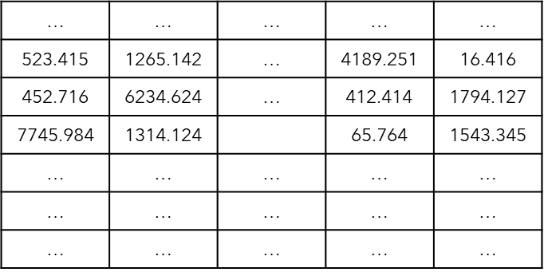
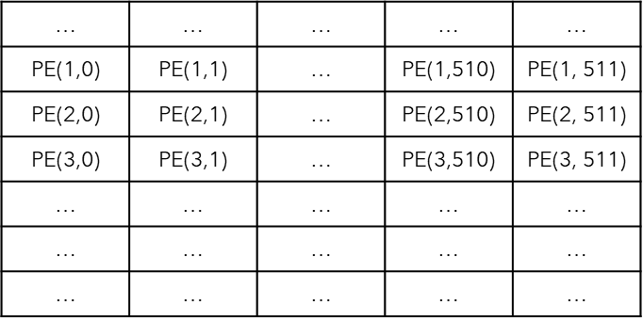




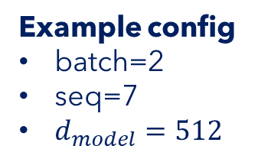





Encoder Input | Final Example
Encoder Input
Example config
batch=2
seq=7
$d_{model}=512$
Positional
Encoding
$$\left(batch, seq, d_{model}\right)$$
$$d_{model}$$
$$\left(batch, seq, d_{model}\right)$$
$$\left(batch, seq, d_{model}\right)$$
$$seq$$
Input Embedding
$$batch$$
Inputs
$$\left(batch, seq\right)$$
2
9
107
550
3
1
1
2
2089
95
75
120
3
1
$$batch$$
"I
am
fine"
"Thank
you
very
much"
$$seq$$

Slide 39
Encoder

Slide 40
Encoder
Prediction Output
Decoder
Encoder
Encoder Input
Decoder Input

Slide 41
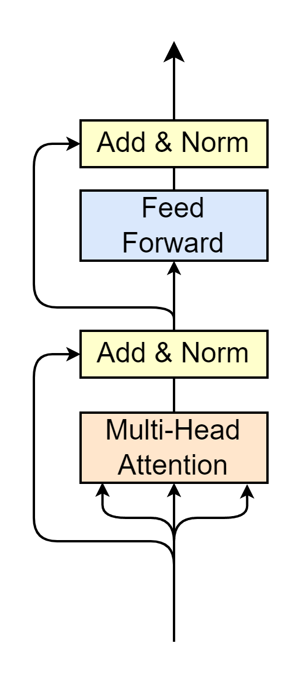
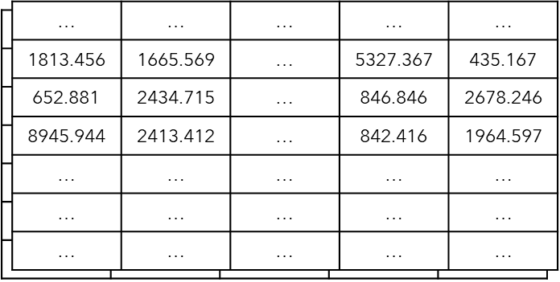



Encoder
Encoder Output
$$\left(batch, seq, d_{model}\right)$$
Multi-Head Attention
Self-Attention
Layer Normalization
Feed Forward
Residual connection
Residual Connection
$$N_{x}$$
Encoder Input
"Word meaning + position feature"
$$\left(batch, seq, d_{model}\right)$$

Slide 42
Multi-Head Attention Self-Attention Mechanism

Slide 43
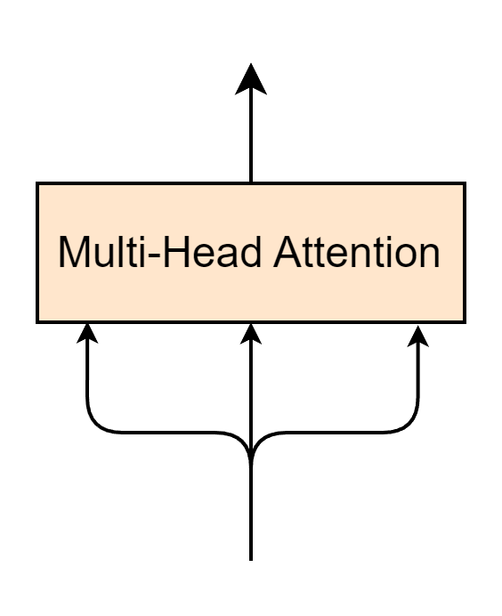











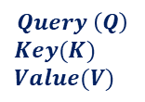
Multi-Head Attention
Encoder Output
$$\left(batch, seq, d_{model}\right)$$
$$\left(batch, seq, d_{model}\right)$$
$$Q$$
$$K$$
$$V$$
$$N_{x}$$
Encoder Input
$$Query \left(Q\right)$$
$$Key(K)$$
$$Value(V)$$
$$\left(batch, seq, d_{model}\right)$$
$$seq$$
$$≡$$
$$batch$$
$$d_{model}$$
Encoder Input
"Word meaning + position feature"
$$\left(batch, seq, d_{model}\right)$$

Slide 44
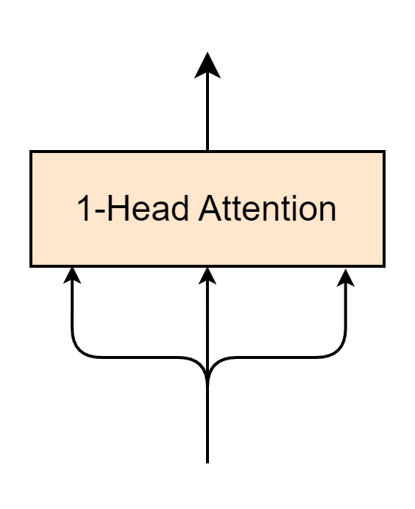
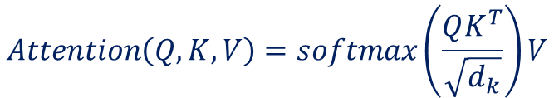
1-Head Attention Layer
$$\left(batch, seq, d_{model}\right)$$
$$Attention\left(Q, K, V\right)=softmax\left(\frac{QK^{T}}{\sqrt{d_{k}}}\right)V$$
$$Q$$
$$K$$
$$V$$
Encoder Input
$$\left(batch, seq, d_{model}\right)$$

Slide 45
Self Attention
Self-Attention
$$\left(batch, seq, d_{model}\right)$$
$$Attention\left(Q, K, V\right)=softmax\left(\frac{QK^{T}}{\sqrt{d_{k}}}\right)V$$
$$Q$$
$$K$$
$$V$$
Encoder Input
$$\left(batch, seq, d_{model}\right)$$

Slide 46

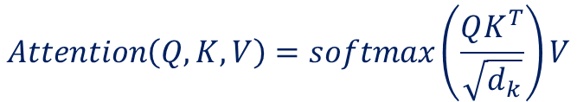






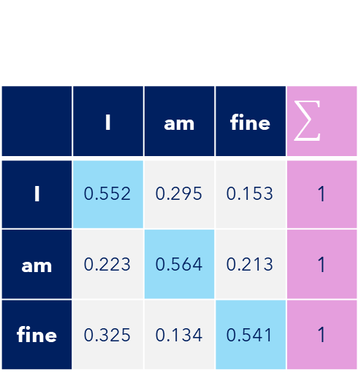

Self-Attention
Self-Attention
Example config
batch=1
seq=3
$d_{model}=d_{k}=512$
$$Attention\left(Q, K, V\right)=softmax\left(\frac{QK^{T}}{\sqrt{d_{k}}}\right)V$$
$$K^{T}(512,3)$$
$$Q(3, 512)$$
1813.456 | 652.881 | 8945.944
1665.569 | 2434.715 | 2413.412
… | … | …
5327.367 | 846.846 | 842.416
435.167 | 2678.246 | 1964.597
Self-Attention$(3,3)$
1813.456 | 1665.569 | … | 5327.367 | 435.167
652.881 | 2434.715 | … | 846.846 | 2678.246
8945.944 | 2413.412 | … | 842.416 | 1964.597
$$×$$
 | I | am | fine
I | 0.552 | 0.295 | 0.153 | 1
am | 0.223 | 0.564 | 0.213 | 1
fine | 0.325 | 0.134 | 0.541 | 1
$$softmax$$
$$=$$
$$\sqrt{512}$$
Self-attention -> Words to relate to each other

Slide 47






1-Head Attention
1-Head Attention
Self-Attention
Example config
batch=1
seq=3
$d_{model}=d_{k}=512$
$$Attention\left(Q, K, V\right)=softmax\left(\frac{QK^{T}}{\sqrt{d_{k}}}\right)V$$
Self-Attention$(3,3)$
 | I | am | fine
I | 0.552 | 0.295 | 0.153 | 1
am | 0.223 | 0.564 | 0.213 | 1
fine | 0.325 | 0.134 | 0.541 | 1
V$(3, 512)$
Attention$(3, 512)$
1813.456 | 1665.569 | … | 5327.367 | 435.167
652.881 | 2434.715 | … | 846.846 | 2678.246
8945.944 | 2413.412 | … | 842.416 | 1964.597
… | … | … | … | …
… | … | … | … | …
… | … | … | … | …
$$×$$
$$=$$
"Word meaning + position feature"
"Word meaning + position feature"
"Relate words to each other"
"Relate words to each other"

Slide 48
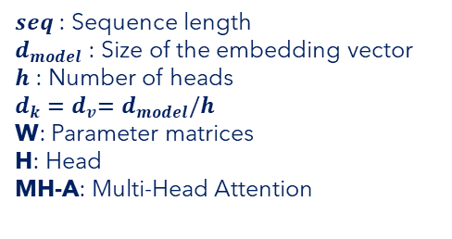
Multi-Head Attention
$seq$ : Sequence length
$d_{model}$ : Size of the embedding vector
$h$ : Number of heads
$d_{k}{=d}_{v}=d_{model}/h$
W: Parameter matrices
H: Head
MH-A: Multi-Head Attention

Slide 49
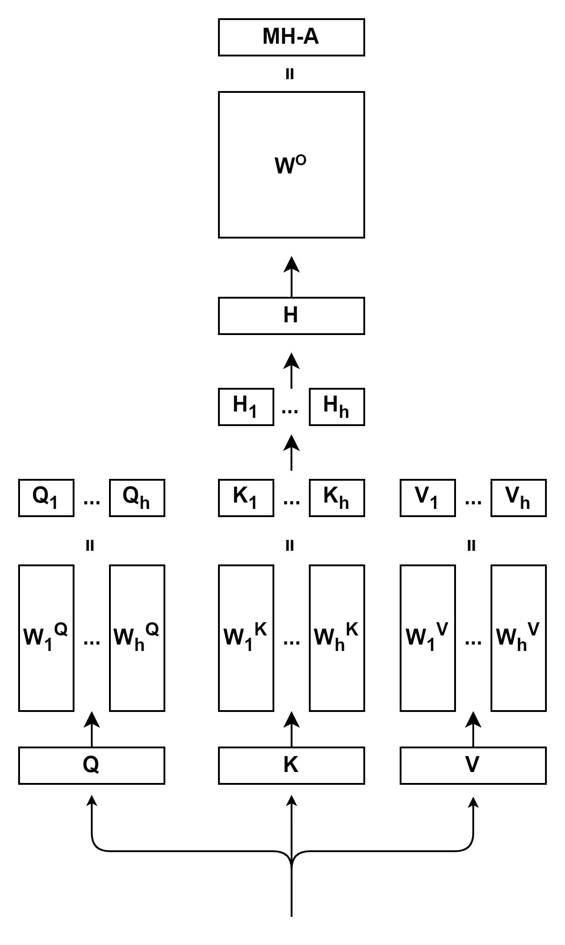
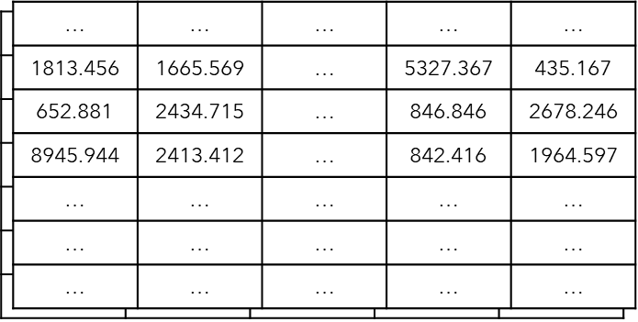


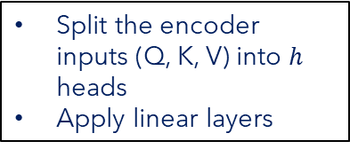




Multi-Head Attention
$seq$ : Sequence length
$d_{model}$ : Size of the embedding vector
$h$ : Number of heads
$d_{k}{=d}_{v}=d_{model}/h$
W: Parameter matrices
H: Head
MH-A: Multi-Head Attention
$$\left(batch, seq, d_{k}\right)$$
$$×$$
$$\left(batch,d_{model}, d_{k}\right)$$
Split the encoder inputs (Q, K, V) into $h$ heads
Apply linear layers
$$batch$$
$$d_{model}$$
$$\left(batch, seq, d_{model}\right)$$
$$seq$$
Encoder Input
$$\left(batch, seq, d_{model}\right)$$

Slide 50



Multi-Head Attention
$seq$ : Sequence length
$d_{model}$ : Size of the embedding vector
$h$ : Number of heads
$d_{k}{=d}_{v}=d_{model}/h$
W: Parameter matrices
H: Head
MH-A: Multi-Head Attention
$$\left(batch, seq, d_{v}\right)$$
$${Head}_{i}=Attention\left(QW_{i}^{Q},KW_{i}^{K},VW_{i}^{V}\right)$$
$$Attention\left(Q, K, V\right)=softmax\left(\frac{QK^{T}}{\sqrt{d_{k}}}\right)V$$
$$\left(batch, seq, d_{k}\right)$$
$$×$$
$$\left(batch,d_{model}, d_{k}\right)$$
Split the encoder inputs (Q, K, V) into $h$ heads
Apply linear layers
$$batch$$
$$d_{model}$$
$$\left(batch, seq, d_{model}\right)$$
$$seq$$
Encoder Input
$$\left(batch, seq, d_{model}\right)$$

Slide 51


Multi-Head Attention
$seq$ : Sequence length
$d_{model}$ : Size of the embedding vector
$h$ : Number of heads
$d_{k}{=d}_{v}=d_{model}/h$
W: Parameter matrices
H: Head
MH-A: Multi-Head Attention
$$\left(batch, seq, d_{model}\right)$$
$$Concat\left(head_{1},⋯,head_{h}\right)$$
$$\left(batch, seq, d_{v}\right)$$
$${Head}_{i}=Attention\left(QW_{i}^{Q},KW_{i}^{K},VW_{i}^{V}\right)$$
$$Attention\left(Q, K, V\right)=softmax\left(\frac{QK^{T}}{\sqrt{d_{k}}}\right)V$$
$$\left(batch, seq, d_{k}\right)$$
$$×$$
$$\left(batch,d_{model}, d_{k}\right)$$
Split the encoder inputs (Q, K, V) into $h$ heads
Apply linear layers
$$batch$$
$$d_{model}$$
$$\left(batch, seq, d_{model}\right)$$
$$seq$$
Encoder Input
$$\left(batch, seq, d_{model}\right)$$

Slide 52



Multi-Head Attention
$$\left(batch, seq, d_{model}\right)$$
$seq$ : Sequence length
$d_{model}$ : Size of the embedding vector
$h$ : Number of heads
$d_{k}{=d}_{v}=d_{model}/h$
W: Parameter matrices
H: Head
MH-A: Multi-Head Attention
$$×$$
$$\left(batch,d_{model}, d_{model}\right)$$
Apply a linear layer
$$\left(batch, seq, d_{model}\right)$$
$$Concat\left(head_{1},⋯,head_{h}\right)$$
$$\left(batch, seq, d_{v}\right)$$
$${Head}_{i}=Attention\left(QW_{i}^{Q},KW_{i}^{K},VW_{i}^{V}\right)$$
$$Attention\left(Q, K, V\right)=softmax\left(\frac{QK^{T}}{\sqrt{d_{k}}}\right)V$$
$$\left(batch, seq, d_{k}\right)$$
$$×$$
$$\left(batch,d_{model}, d_{k}\right)$$
Split the encoder inputs (Q, K, V) into $h$ heads
Apply linear layers
$$batch$$
$$d_{model}$$
$$\left(batch, seq, d_{model}\right)$$
$$seq$$
Encoder Input
$$\left(batch, seq, d_{model}\right)$$

Slide 53
Layer Normalization

Slide 54

Layer Normalization
Encoder Output
$$\left(batch, seq, d_{model}\right)$$
$$N_{x}$$
Encoder Input
$$\left(batch, seq, d_{model}\right)$$

Slide 55
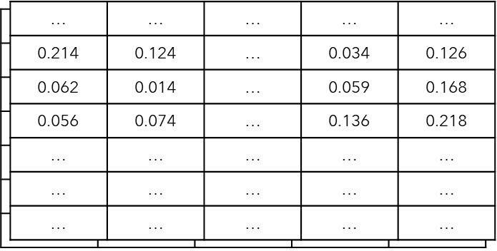
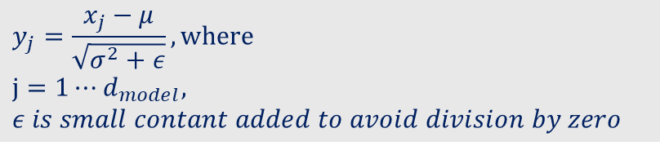

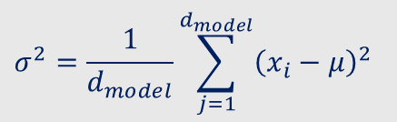







Layer Normalization
Given a feature vector of a token, having length of $d_{model}$
Calculate mean and variance
Normalization
$$x_{1}$$
$$x_{d_{model}}$$
 |  | …
$$\left(batch, seq,d_{model}\right)$$
Layer Normalization
$$μ=\frac{1}{d_{model}}\sum_{j=1}^{d_{model}}{x_{j}}$$
$$σ^{2}=\frac{1}{d_{model}}\sum_{j=1}^{d_{model}}{{\left(x_{i}−μ\right)}^{2}}$$
$$\left(batch, seq,d_{model}\right)$$
$$batch$$
$$y_{j}=\frac{x_{j}−μ}{\sqrt{σ^{2}+ε}}, where$$
$$j=1⋯d_{model},$$
$ε is small contant added to avoid division by zero$
$$seq$$
$$d_{model}$$
$$y_{1}$$
$$y_{d_{model}}$$
 |  | …

Slide 56
Feed Forward

Slide 57
Feed Forward
Encoder Output
$$\left(batch, seq, d_{model}\right)$$
$$N_{x}$$
Encoder Input
$$\left(batch, seq, d_{model}\right)$$

Slide 58
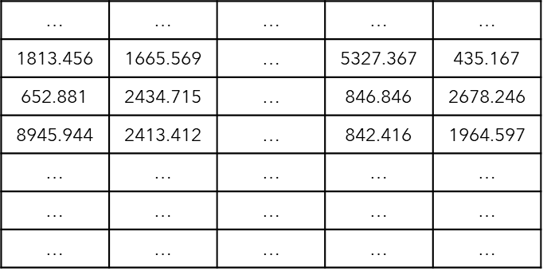

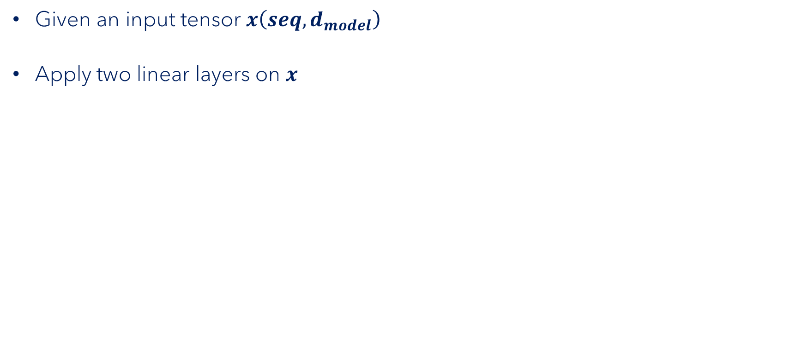









Feed Forward
$$seq$$
Given an input tensor $x\left(seq,d_{model}\right)$
Apply two linear layers on $x$
Obtain output tensor$y\left(seq,d_{model}\right)$
$$d_{model}$$
$$W_{1}$$
$$x$$
$$×$$
$$+$$
$$b_{1}$$
$$\left(seq,d_{model}\right)$$
$$\left(d_{model},d_{ff}\right)$$
$$Linear layer 1 \left(seq,d_{ff}\right)$$

Slide 59

Feed Forward
$$seq$$
Given an input tensor $x\left(seq,d_{model}\right)$
Apply two linear layers on $x$
Obtain output tensor$y\left(seq,d_{model}\right)$
$$d_{model}$$
$$W_{1}$$
$$x$$
$$×$$
$$+$$
$$b_{1}$$
$$ReLU$$
$$\left(seq,d_{model}\right)$$
$$\left(d_{model},d_{ff}\right)$$
$$Linear layer 1 \left(seq,d_{ff}\right)$$

Slide 60







Feed Forward
$$seq$$
Given an input tensor $x\left(seq,d_{model}\right)$
Apply two linear layers on $x$
Obtain output tensor$y\left(seq,d_{model}\right)$
$$d_{model}$$
$$y=FF\left(x\right)=ReLU\left(x{×W}_{1}+b_{1}\right)×W_{2}+b_{2} , where ReLU\left(x\right)=max(0,x)$$
$$W_{1}$$
$$W_{2}$$
$$FF\left(x\right)=$$
$$x$$
$$×$$
$$+$$
$$b_{1}$$
$$×$$
$$+$$
$$b_{2}$$
$$ReLU$$
$$\left(seq,d_{model}\right)$$
$$\left(d_{ff},d_{model}\right)$$
$$\left(d_{model},d_{ff}\right)$$
$$Linear layer 1 \left(seq,d_{ff}\right)$$
$$Linear layer 2 \left(seq,d_{model}\right)$$

Slide 61
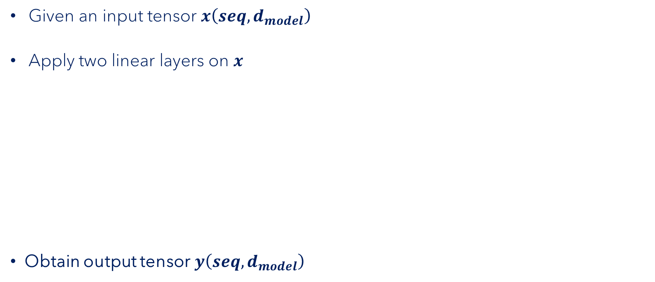
Feed Forward
$$seq$$
Given an input tensor $x\left(seq,d_{model}\right)$
Apply two linear layers on $x$
Obtain output tensor$y\left(seq,d_{model}\right)$
$$d_{model}$$
$$y=FF\left(x\right)=ReLU\left(x{×W}_{1}+b_{1}\right)×W_{2}+b_{2} , where ReLU\left(x\right)=max(0,x)$$
$$W_{1}$$
$$W_{2}$$
$$FF\left(x\right)=$$
$$x$$
$$×$$
$$+$$
$$b_{1}$$
$$×$$
$$+$$
$$b_{2}$$
$$ReLU$$
$$\left(seq,d_{model}\right)$$
$$\left(d_{ff},d_{model}\right)$$
$$\left(d_{model},d_{ff}\right)$$
$$Linear layer 1 \left(seq,d_{ff}\right)$$
$$Linear layer 2 \left(seq,d_{model}\right)$$

Slide 62
Residual Connection

Slide 63
Residual Connection
Encoder Output
$$\left(batch, seq, d_{model}\right)$$
Residual Connection
$$N_{x}$$
Encoder Input
$$\left(batch, seq, d_{model}\right)$$

Slide 64


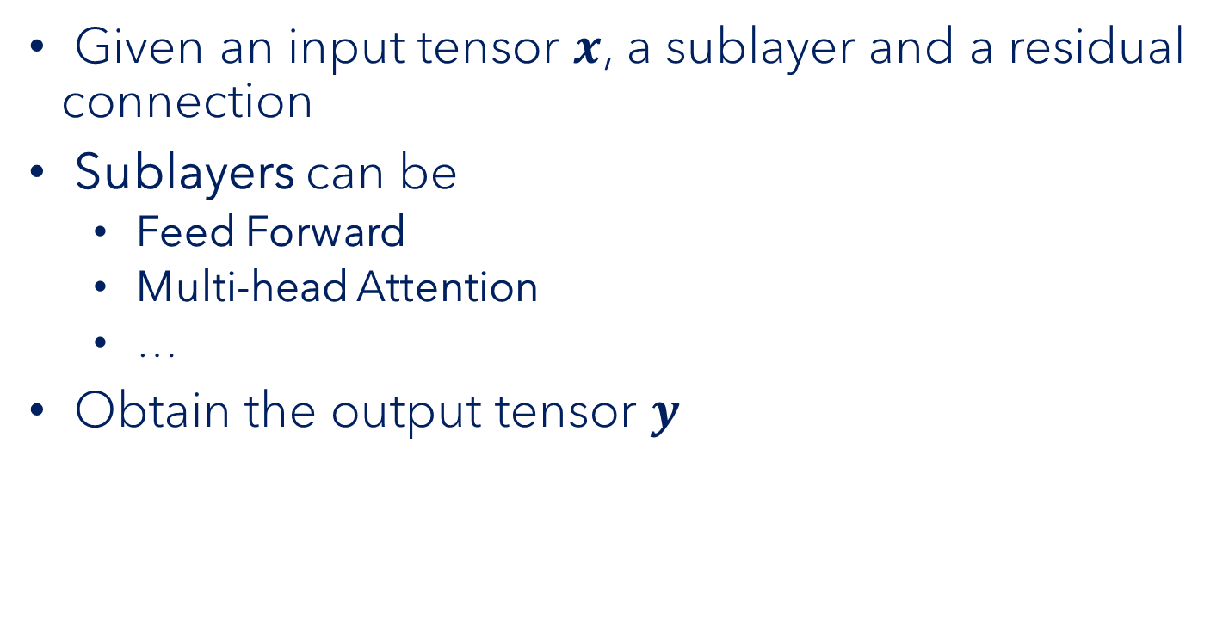



Residual Connection
$$y$$
$$+$$
Given an input tensor $x$, a sublayer and a residual connection
Sublayers can be
Feed Forward
Multi-head Attention
…
Obtain the output tensor $y$
$$Sublayer$$
$$x$$
$$y =x+sublayer(x)$$

Slide 65
Encoder Put it all together

Slide 66
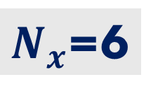
Encoder | Put it all together
Encoder Output
$$\left(batch, seq, d_{model}\right)$$
Multi-Head Attention
Self-Attention
Layer Normalization
Feed Forward
Residual connection
Residual Connection
$N_{x}$=6
Encoder Input
$$\left(batch, seq, d_{model}\right)$$

Slide 67
Decoder

Slide 68
Decoder
Prediction Output
Decoder
Encoder
Encoder Input
Decoder Input

Slide 69
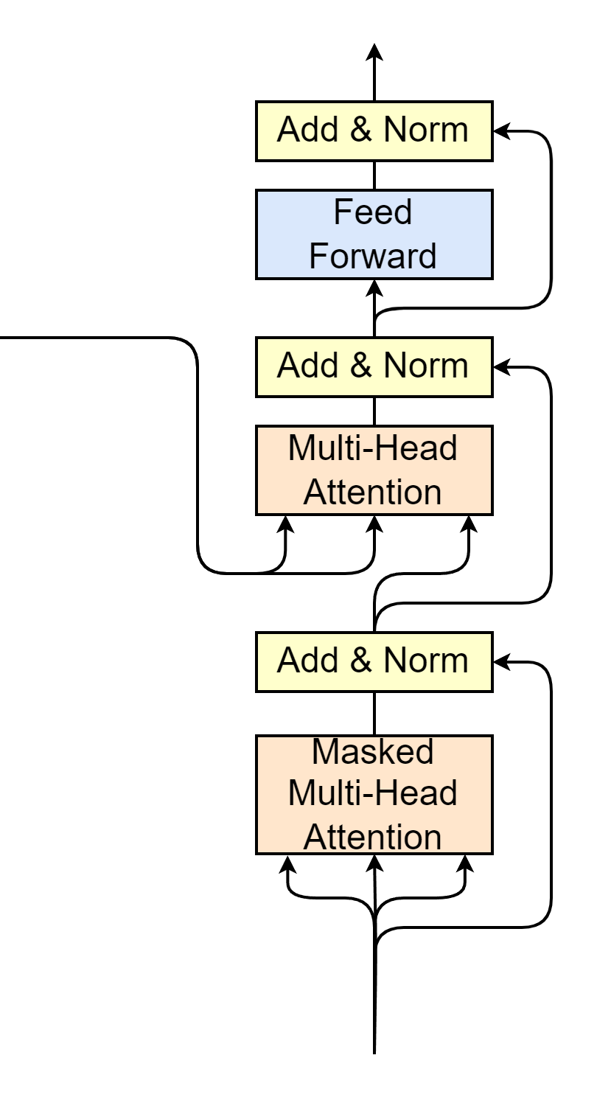

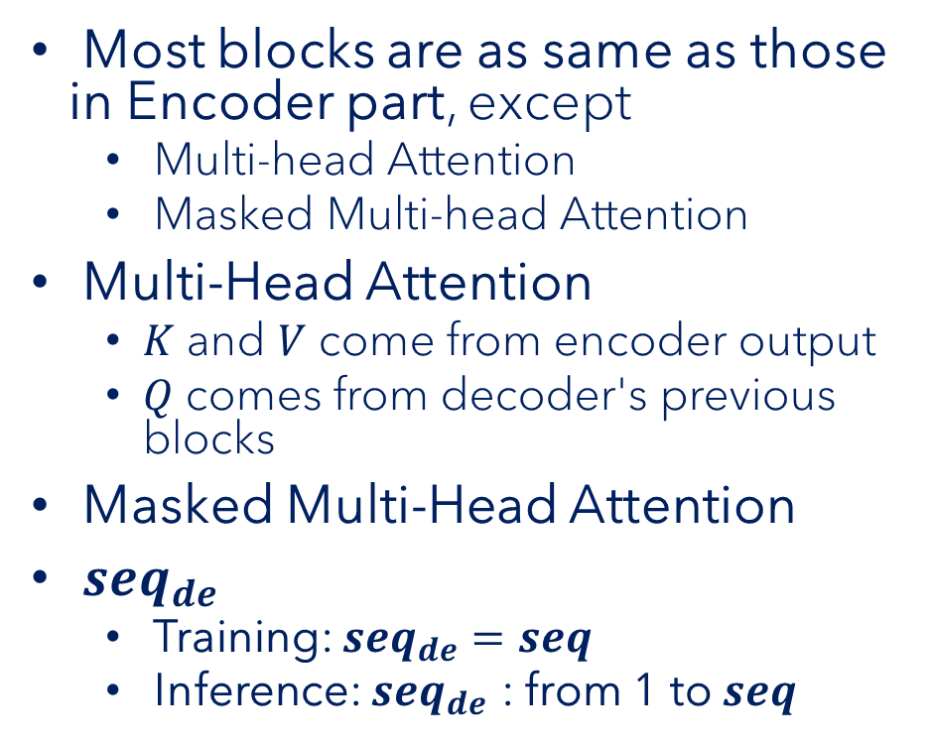







Decoder
Decoder Input
$$\left(batch, seq_{de}, d_{model}\right)$$
Most blocks are as same as those in Encoder part, except
Multi-head Attention
Masked Multi-head Attention
Multi-Head Attention
$K$ and $V$ come from encoder output
$Q$ comes from decoder's previous blocks
Masked Multi-Head Attention
$seq_{de}$
Training: $seq_{de}=seq$
Inference: $seq_{de}$ : from 1 to $seq$
Encoder Output
$$\left(batch, seq, d_{model}\right)$$
$$K$$
$$V$$
$$Q$$
$$N_{x}$$
$$\left(batch, seq_{de}, d_{model}\right)$$
Decoder Input
$$\left(batch, seq_{de}, d_{model}\right)$$

Slide 70
Masked Multi-Head Attention

Slide 71


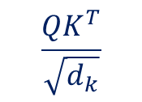
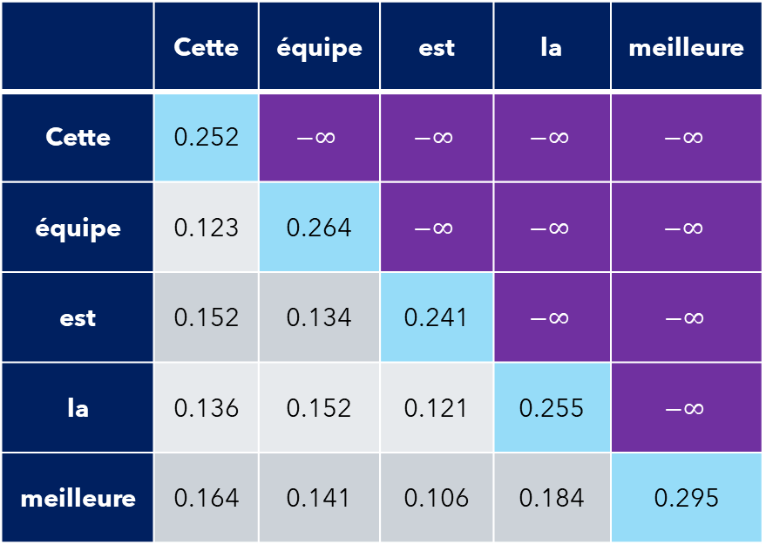
Masked Multi-Head Attention
$$Attention\left(Q, K, V\right)=softmax\left(\frac{QK^{T}}{\sqrt{d_{k}}}\right)V$$
Self-attention
$$\frac{QK^{T}}{\sqrt{d_{k}}}$$
Apply mask matrix
Each word only correlates with previous words
 | Cette | équipe | est | la | meilleure
Cette | 0.252 | $$−∞$$ | $$−∞$$ | $$−∞$$ | $$−∞$$
équipe | 0.123 | 0.264 | $$−∞$$ | $$−∞$$ | $$−∞$$
est | 0.152 | 0.134 | 0.241 | $$−∞$$ | $$−∞$$
la | 0.136 | 0.152 | 0.121 | 0.255 | $$−∞$$
meilleure | 0.164 | 0.141 | 0.106 | 0.184 | 0.295
 | Cette | équipe | est | la | meilleure
Cette | 1.0 | 0 | 0 | 0 | 0
équipe | 0.465 | 0.525 | 0 | 0 | 0
est | 0.325 | 0.319 | 0.356 | 0 | 0
la | 0.242 | 0.246 | 0.239 | 0.273 | 0
meilleure | 0.197 | 0.192 | 0.186 | 0.201 | 0.224
$$softmax$$

Slide 72
Multi-Head Attention for Decoder

Slide 73
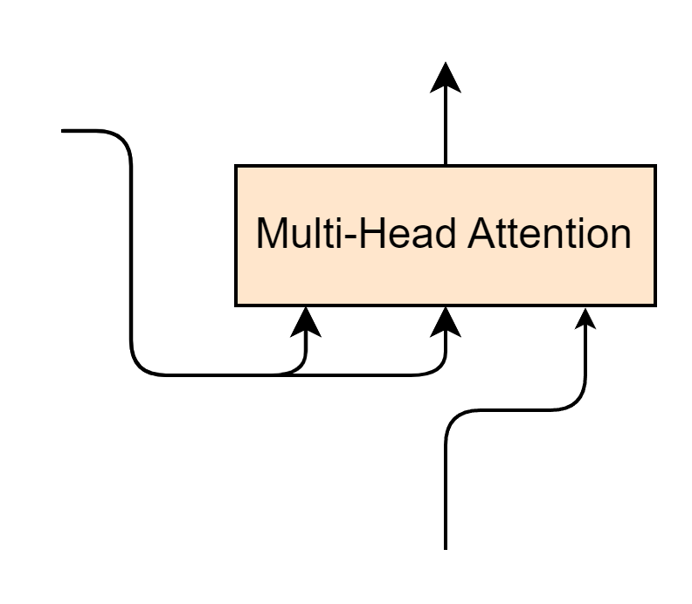




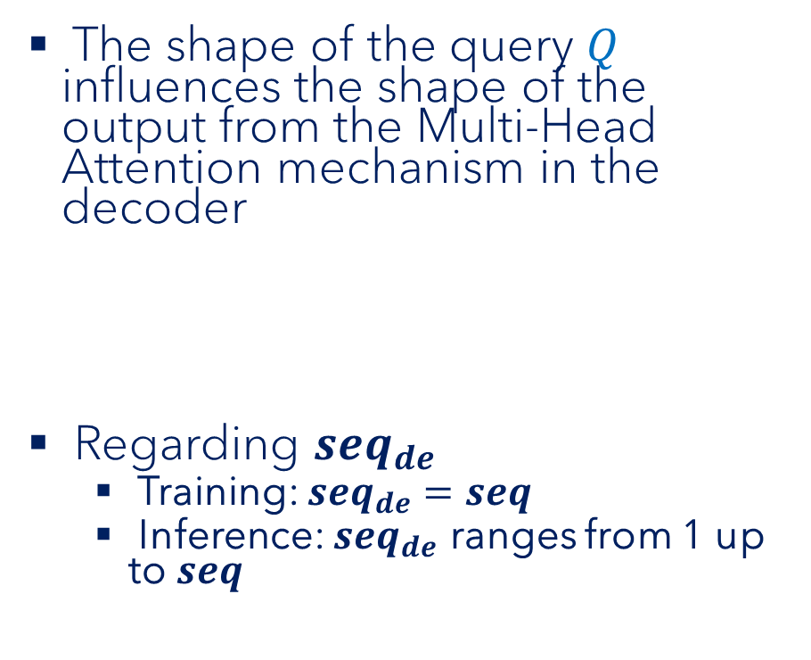



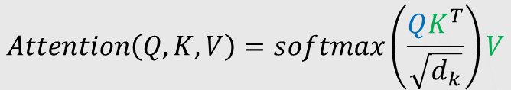



Multi-Head Attention for Decoder
The shape of the query $Q$ influences the shape of the output from the Multi-Head Attention mechanism in the decoder
Regarding $seq_{de}$
Training: $seq_{de}=seq$
Inference: $seq_{de}$ ranges from 1 up to $seq$
$$\left(batch, seq_{de}, d_{model}\right)$$
Encoder Output
$$\left(batch, seq, d_{model}\right)$$
$$K$$
$$V$$
$$Q$$
$$Q$$
$$K^{T}$$
$$V$$
$$\left(\left(seq_{de}, d_{model}\right)×\left(d_{model},seq\right)\right)×(seq, d_{model})$$
$$\left(seq_{de}, d_{model}\right)$$
$$\left(batch, seq_{de}, d_{model}\right)$$
$$Attention\left(Q, K, V\right)=softmax\left(\frac{QK^{T}}{\sqrt{d_{k}}}\right)V$$

Slide 74
Decoder Put it all together

Slide 75


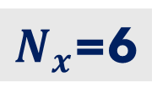




Decoder | Put it all together
Decoder Output
$$\left(batch, seq, d_{model}\right)$$
Multi-Head Attention
Masked Multi-Head Attention
Encoder Output
$$\left(batch, seq, d_{model}\right)$$
$N_{x}$=6
$$K$$
$$V$$
$$Q$$
Decoder Input
$$\left(batch, seq_{decoder}, d_{model}\right)$$

Slide 76
Prediction Output

Slide 77
Prediction Output
Prediction Output
Projection
Linear layer
Softmax
Decoder
Encoder
Encoder Input
Decoder Input

Slide 78
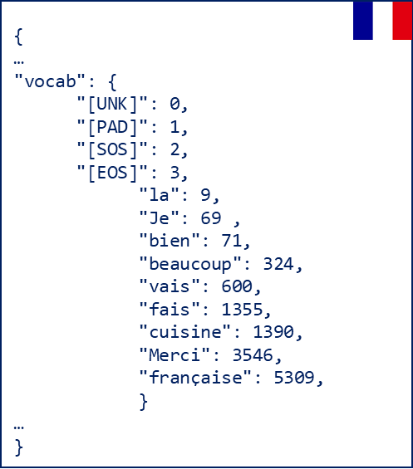



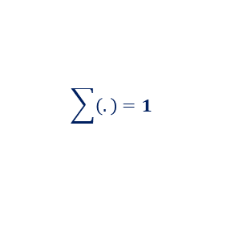











Prediction Output Example
Target Tokenizer
"Je"
Given a decoder output $x\left(batch, seq_{de},d_{model}\right)$
The Linear layer projects $x$ to $y\left(batch, seq_{de},vocal_{size} \right)$
Apply Softmax
Tokenizer decodes
decode
$$vocal_size=10000$$
$$idx=69$$
0.03 | 0.04 | … | … | 0.86 | ... | … | … | … | 0.04
$$\sum{\left(.\right)}=1$$
$$softmax$$
3.42 | 4.65 | … | … | 86.45 | ... | … | … | … | 4.15
$$W$$
$$vocal_size=10000$$
$$Linear\left(x\right)=$$
$$x$$
$$×$$
$$+$$
$$b$$
Linear
$$\left(d_{model},vocal_size\right)$$
214.241 | 421.145 | … | 102.541 | 312.264
$$\left(seq_{de},d_{model}\right)$$
$$d_{model}=512$$

Slide 79
Congratulations
Prediction Output
Decoder
Encoder
Encoder Input
Decoder Input

Slide 80
Transformer's Training Process

Slide 81
Training Process
Source language
Training
Trained transformer model
Target language
For Machine Translation task

Slide 82
Training Illustration (1/2)
Target
"C'est bon"
t1
C'est bon <EOS>
Cross Entropy Loss
X Y Z
Decoder
Encoder
Update model parameters
<SOS> It's good <EOS>
<SOS> C'est bon
Source
Target
"It's good"
"C'est bon"

Slide 83
Training Illustration (2/2)
Target
"Je t'aime"
t2
Je t'aime<EOS>
Cross Entropy Loss
I J K
Decoder
Encoder
Update model parameters
<SOS> I love <EOS>
<SOS> Je t'aime
Source
Target
"I love you"
"Je t'aime"

Slide 84
Transformer's Inference Process

Slide 85
Inference Process
Source
Target
"I am fine"
?

Slide 86
Inference Illustration (1/4)
t1
Je
Decoder
Encoder
<SOS> I am fine <EOS>
<SOS>
Source
"I am fine"

Slide 87
Inference Illustration (2/4)
t2
Je
Decoder
Encoder
<SOS> I am fine <EOS>
<SOS>
Source
"I am fine"

Slide 88
Inference Illustration (2/4)
t2
vais
Decoder
Encoder
<SOS> I am fine <EOS>
<SOS> Je
Source
"I am fine"

Slide 89
Inference Illustration (3/4)
t3
vais
Decoder
Encoder
<SOS> I am fine <EOS>
<SOS> Je
Source
"I am fine"

Slide 90
Inference Illustration (3/4)
t3
bien
Decoder
Encoder
<SOS> I am fine <EOS>
<SOS> Je vais
Source
"I am fine"

Slide 91
Inference Illustration (4/4)
t4
bien
Decoder
Encoder
<SOS> I am fine <EOS>
<SOS> Je vais
Source
"I am fine"

Slide 92
Inference Illustration (4/4)
t4
Prediction
"Je vais bien"
<EOS>
Decoder
Encoder
<SOS> I am fine <EOS>
<SOS> Je vais bien
Source
"I am fine"

Slide 93
What We Have Learned

Slide 94
What We Have Learned
NLP landscape before & after Transformer's arrival in 2017
Advantages & disadvantages of RNN
How Transformer has revolutionized AI & NLP since its arrival
Transformer's block-by-block
Training and inference processes in Transformer

